Slide 1

Version control with Git Part II
Shuai Wei
IS&T Research Computing Services
Boston University

Slide 2
Git: main features
Track all your changes
Work along with others
Share work with others
With Git

Slide 3
Git Workflow
git init <folder_name> (as in tutorial part one)
Local
computer
git add <file_name>
git commit -m “messages”
Github.com

Slide 4
Installing Git

Slide 5
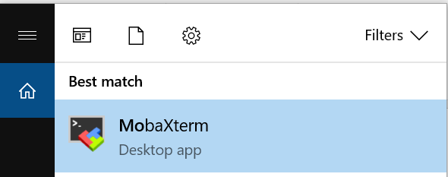
Login to the SCC
Username: tuta#
Password: VizTut#
#-is the number located on your computer
Note:
•Username and password are case-sensitive
•password will not be displayed while you are typing it

Slide 6
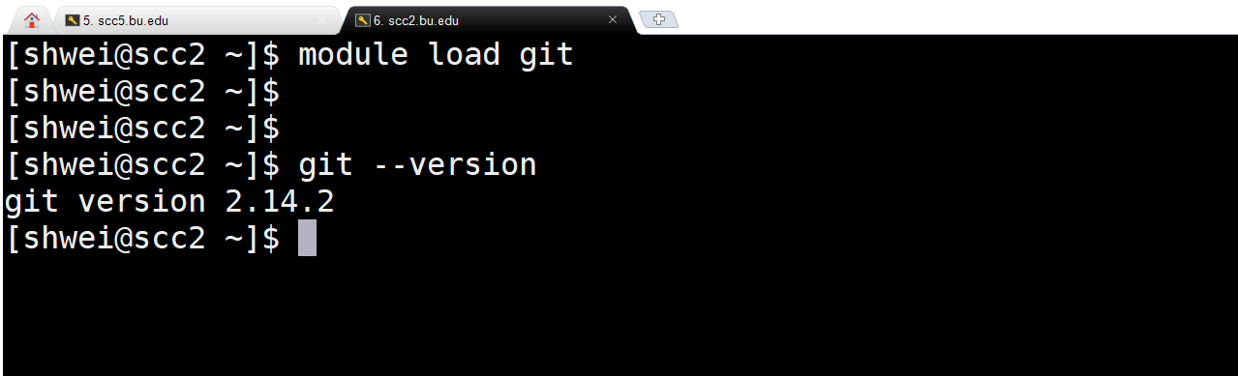
Git: basic configuration
# select the latest version of git
# check gitversion

Slide 7
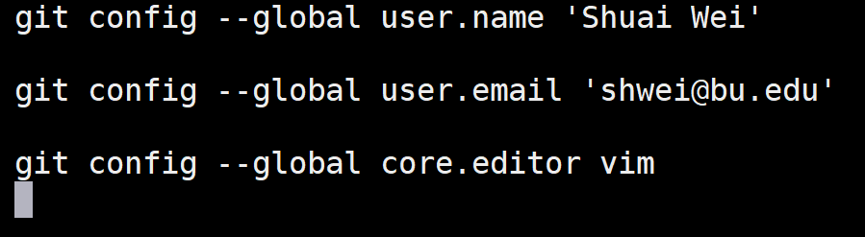
Git basic configuration
Command
Flag
Key
Value
Interpreter
program
Notes:
•Vim is the default editor used by git
•Select gedit if you are not familiar with vim or emacs editors

Slide 8
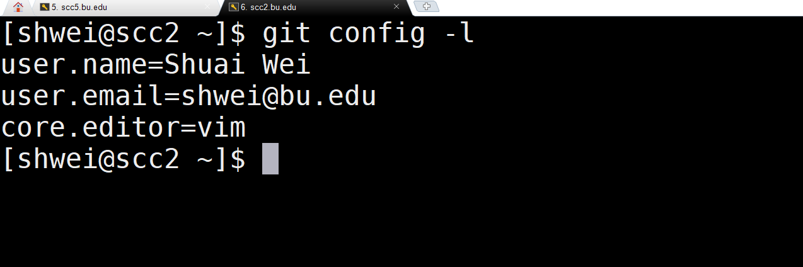
Git basic configuration

Slide 9
Now we prepare the working folder for a new repository.

Slide 10
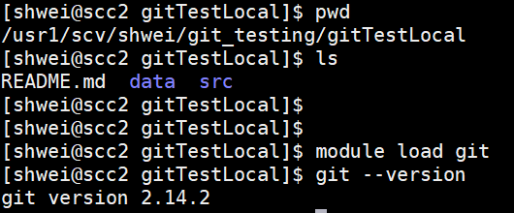
Git init from a local folder
Let’s prepare this folder to your local computer:
Prepare the working folder.
Get the git ready.

Slide 11
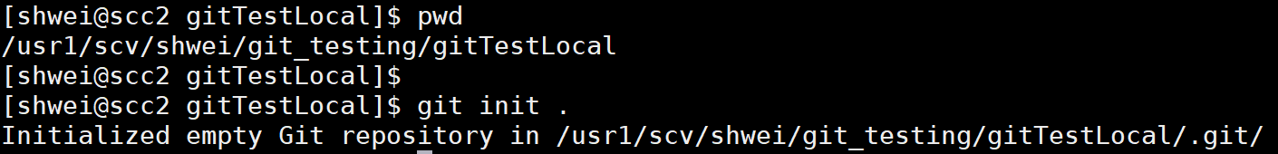
Init the git repository for folder “gitTestLocal”
Now the local repository is created.

Slide 12
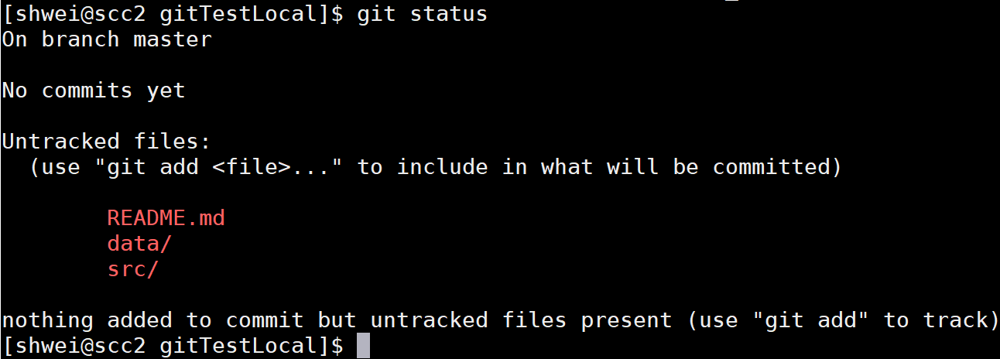
Init the git repository for folder “gitTestLocal”
Assuming that we don’t want to track the large data folder.

Slide 13
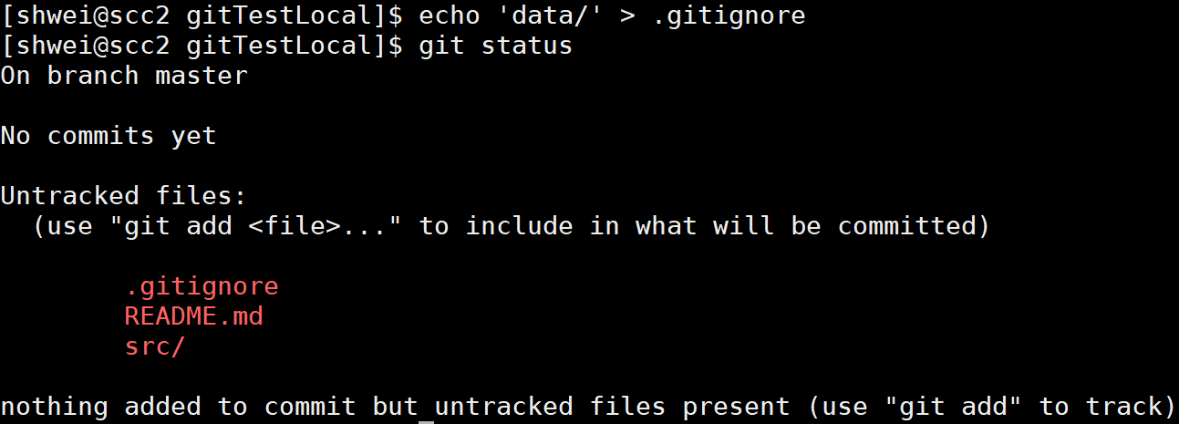
Ignore the data file under the data/ folder (before staging files)
List the folder name in the ignore file

Slide 14
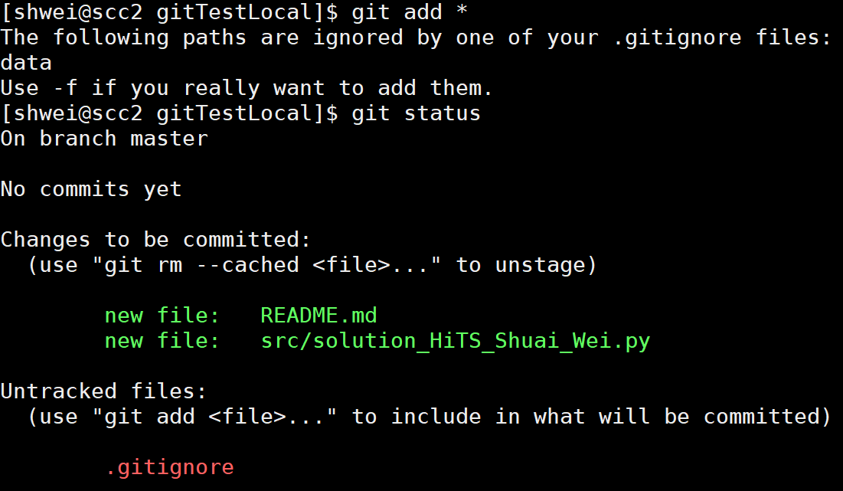
Stage all files by using *

Slide 15
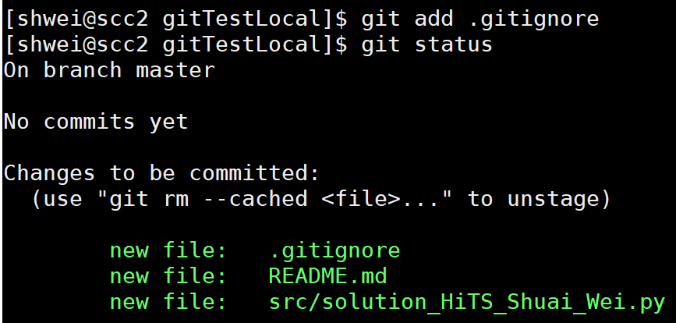
Git add the .gitignore file

Slide 16
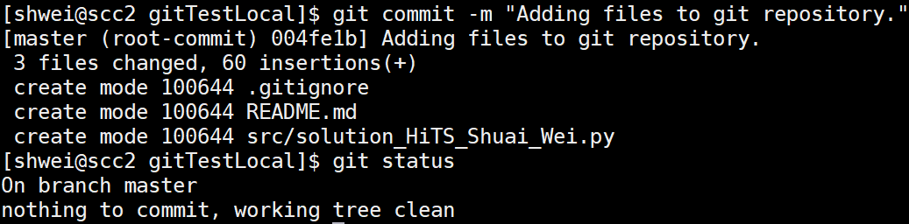
Git commit
Commit with a message:

Slide 17
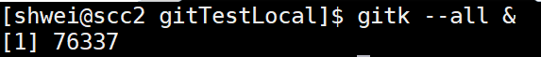
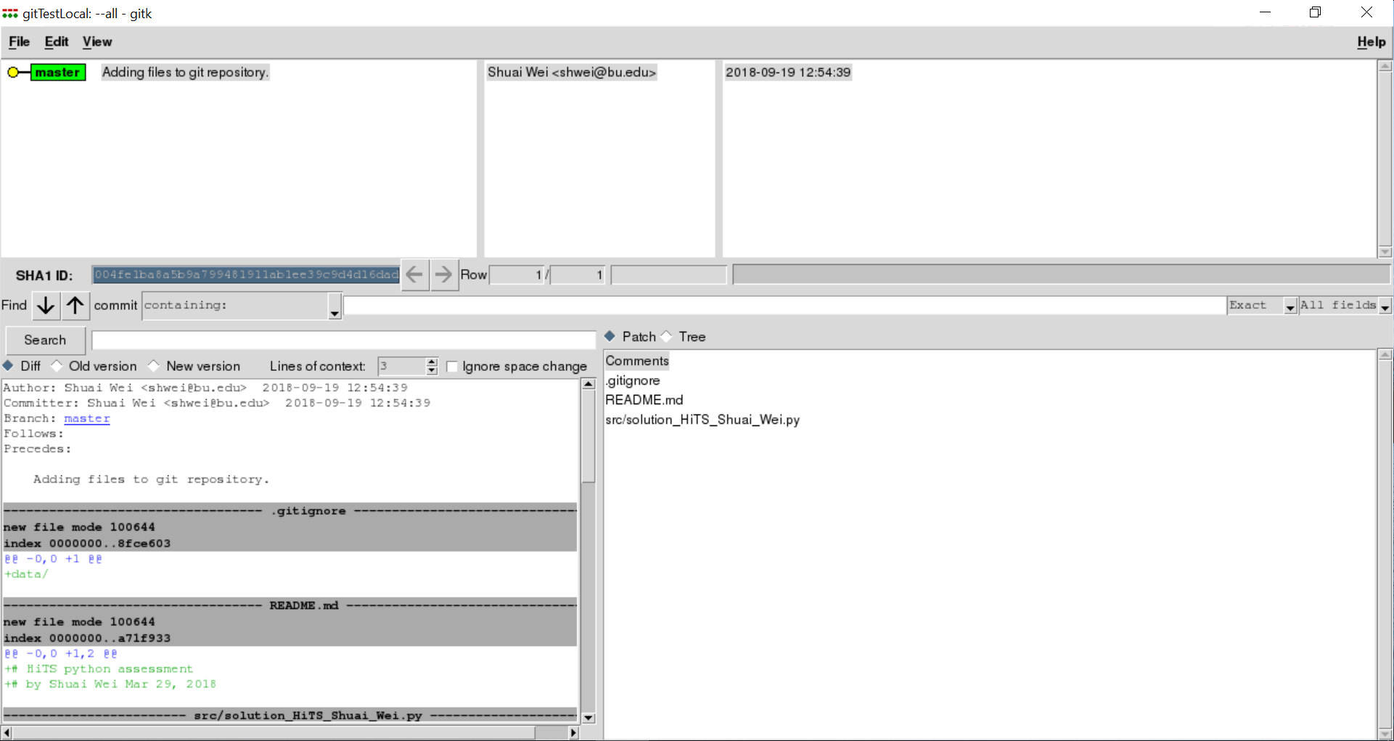
Start the gitk for visualization

Slide 18
Now we make some commits

Slide 19
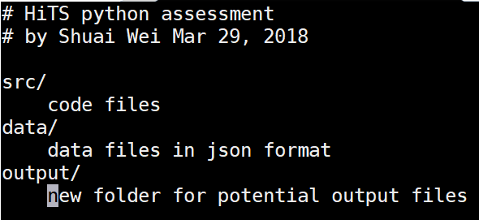
Edit the README.md file
Use your favorite editor to edit the README.md file
Save and exit it.
git add/commit -m ‘Editing README.md file’

Slide 20
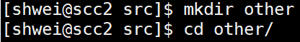

Add sub-folder and a new code file in it.
Save and exit it.
git
status
add *
commit -m ‘Adding test0.py file in a new sub-folder src/other/’

Slide 21
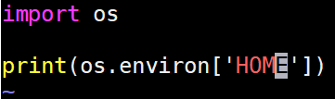
Add an another new code file in it.
Save and exit it.
git
status
add *
commit -m ‘Adding test1.py file in src/other/’

Slide 22
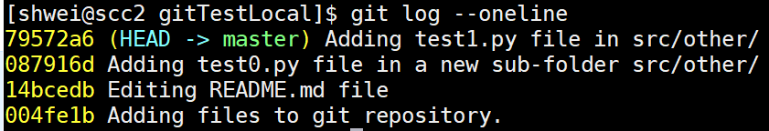
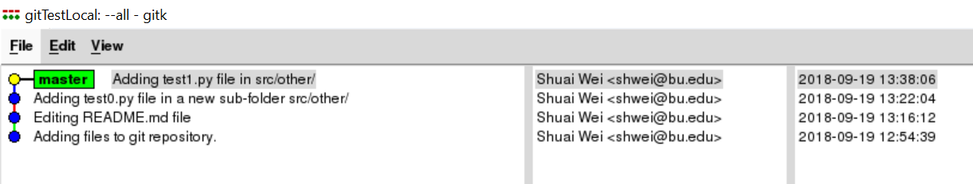
Check the workflow now
Using git log in terminal
Using gitk

Slide 23
Checkout a previous commit and checkout a new branch.

Slide 24
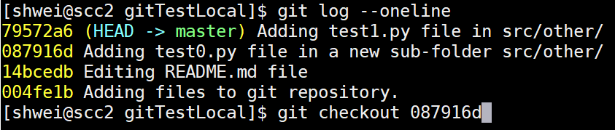
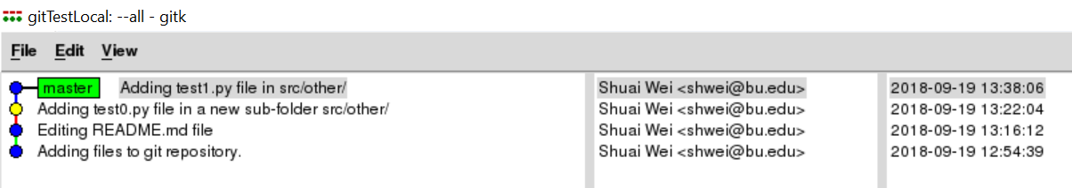
Checkout a previous commit

Slide 25
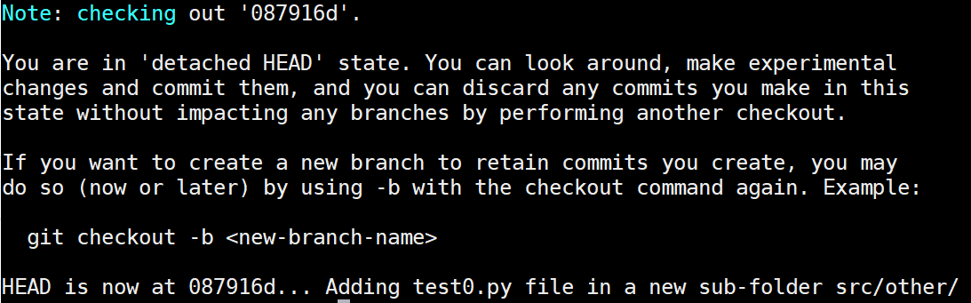
Git guess we want to create a new branch
Recommended by git

Slide 26
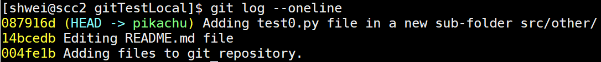
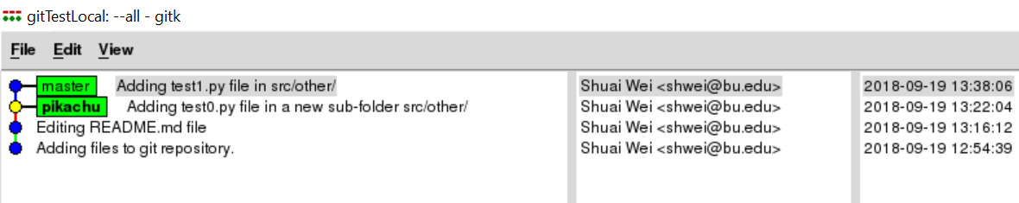
Checkout a new branch name “pikachu”

Slide 27
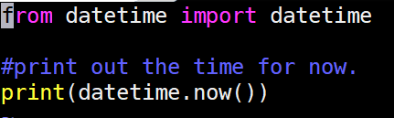
Let’s make some commits on the new branch: new file name “test2.py”
Save and exit it.
git
status
add *
commit -m ‘Adding test2.py file in src/other/’

Slide 28
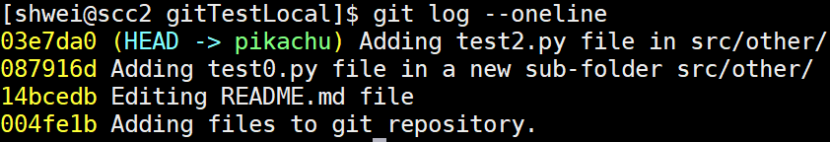
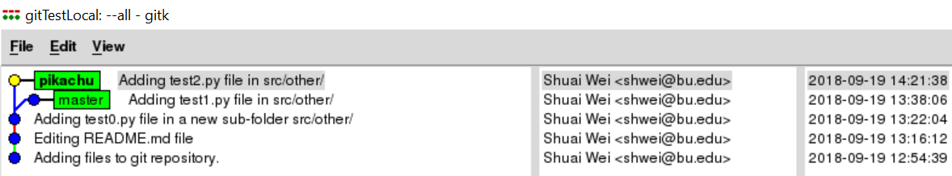
Review the commit and the git repository structure.

Slide 29
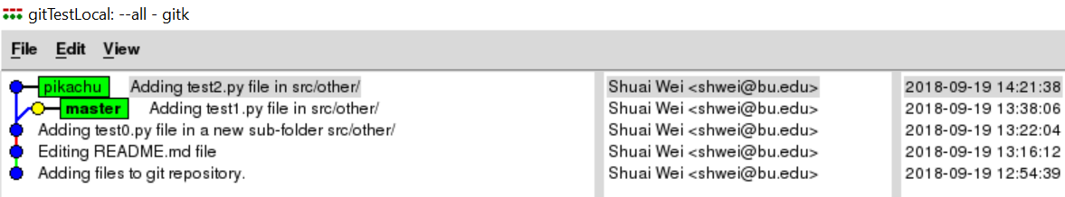
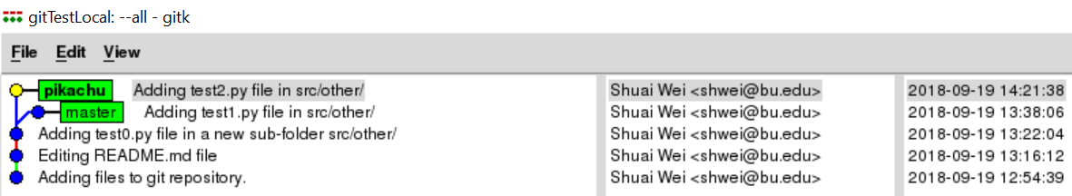
Switch back and forth between branches

Slide 30
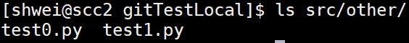
Different files available on the two branches

Slide 31
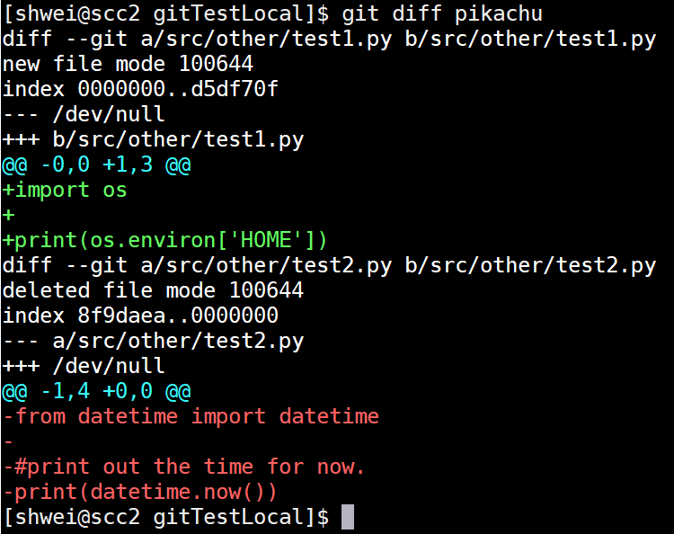
Show the difference
On the master branch:

Slide 32
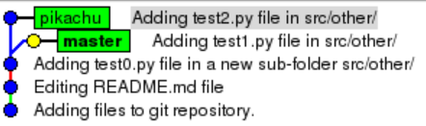
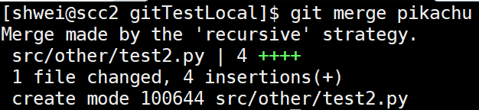
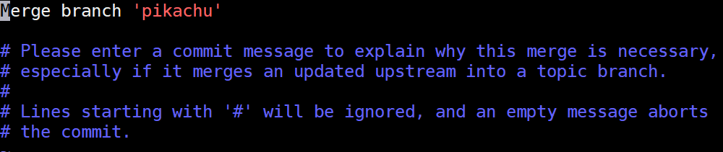
Merge
On the master branch:

Slide 33
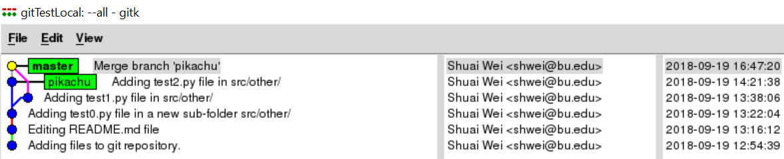
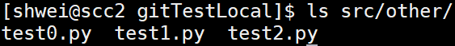
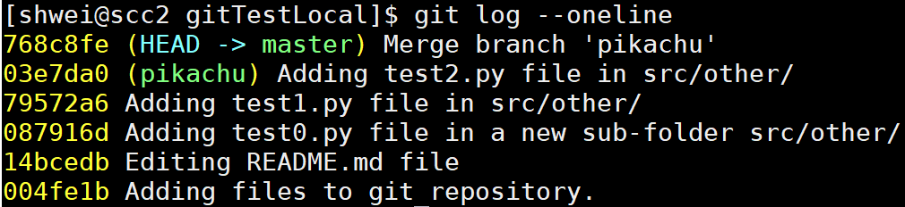
Merged commit on master
All files

Slide 34
Create a new branch and work with a file with the same name on another branch.

Slide 35
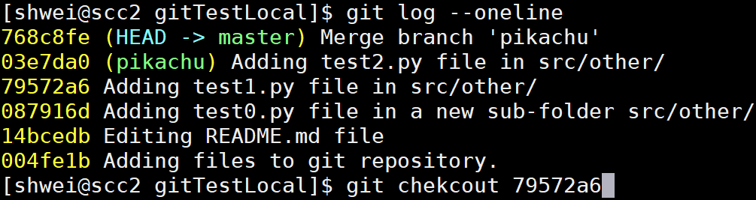
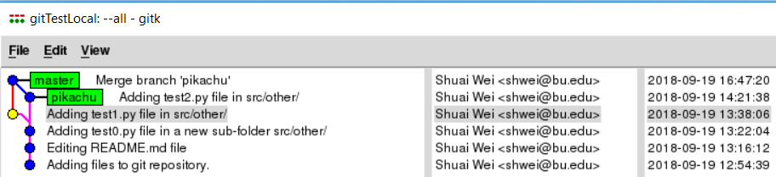
Checkout a previous commit

Slide 36
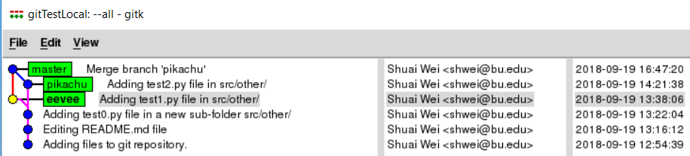
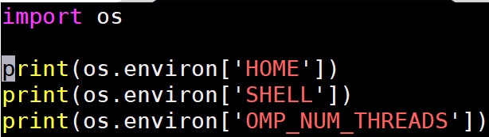
Create a new branch “eevee”
Edit the “test1.py” file to make some conflicts with the master branch.
Adding two lines.

Slide 37
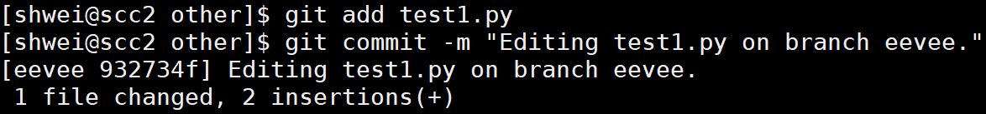
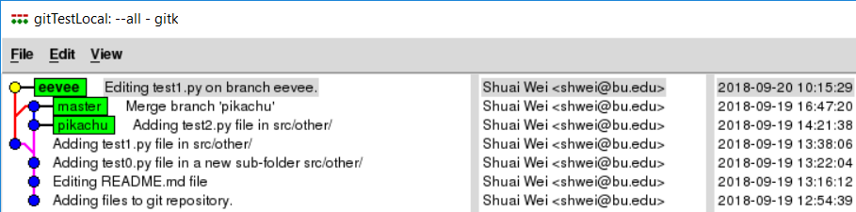
Commit the changes for the “test1.py”

Slide 38
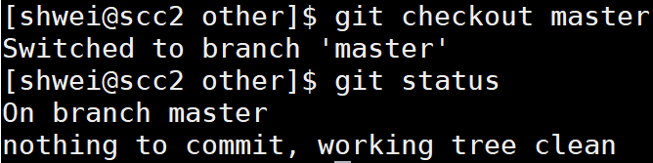
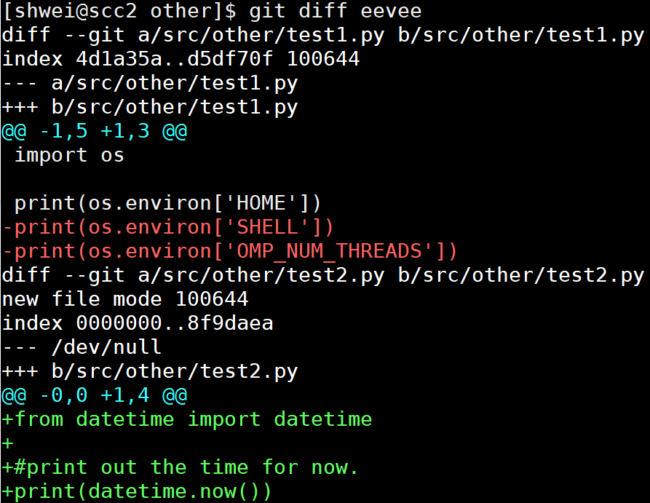
Go back to master branch and check the diff

Slide 39
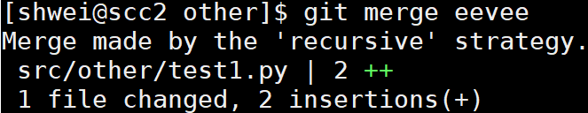
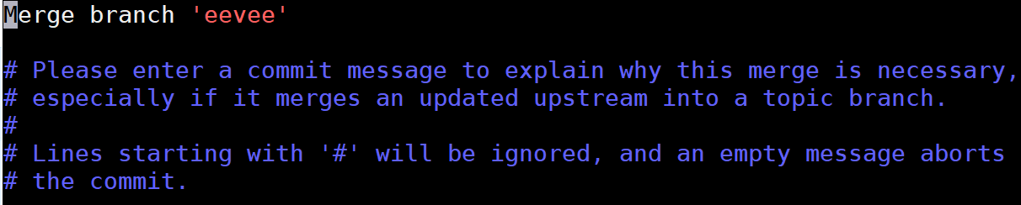
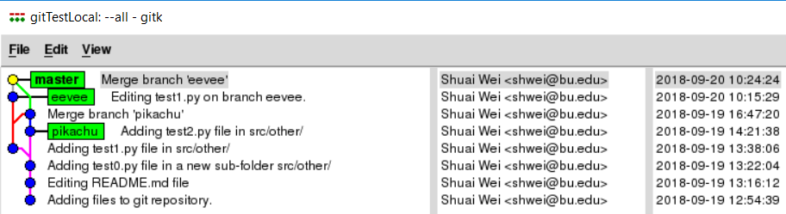
Merge eevee to master
The eevee branch is automatically merged to
the master branch by adding two lines in the
same file.

Slide 40
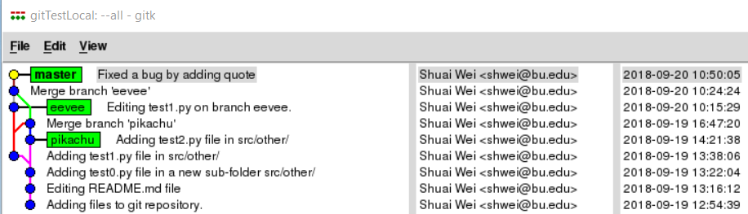
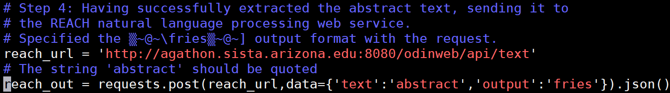
On the master branch: fix a bug
Note: save/exit it. Git add/commit it.

Slide 41
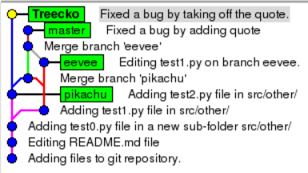



On the new “Treecko” branch: fix the same bug in a different (wrong) way.
Note: save/exit it. Git add/commit it.

Slide 42

Go back to master branch and merge “Treecko”

Slide 43

Even though auto-merge failed, git helps:
Open the file that contains merging conflicts: “solution_HiTS_Shuai_Wei.py”

Slide 44

Still on the master branch
Simply edit it as you want, save and exit it.

Slide 45
Interfacing remote server and collaboration.

Slide 46

Git remote

Slide 47

Github.com
A web-server that allows you to save/access your repository remotely.
Easy to share with collaborators.

Slide 48

New repository

Slide 49

Input your repository name and create it.

Slide 50

Since we have an existing repository on local:

Slide 51



Make some new commit locally and “push” it to your remote.

Slide 52

Adding a collaborator

Slide 53

Then your collaborator will be able to access your repository.

Slide 54
Other resources to learn Git:
https://help.github.com/desktop/
http://try.github.io/
https://www.atlassian.com/git/tutorials
git help

Slide 55
Thank you for attending the tutorial!
Please fill the evaluation form:
http://scv.bu.edu/survey/tutorial_evaluation.html
Questions:
help@scc.bu.edu

